Slide 1

Angular
Tommy Barnes & Kunal Sinha
Associate Consultants
Premier Developer

Slide 2
Agenda
Day 1
Set Up Our Environment
Modules
Components
Templates
Classes
Data Binding
Pipes
Directives
Day 2
Services
Http Service
Routing
Forms
Testing
Webpack
Notes:
Installing node will also install npm

Slide 3
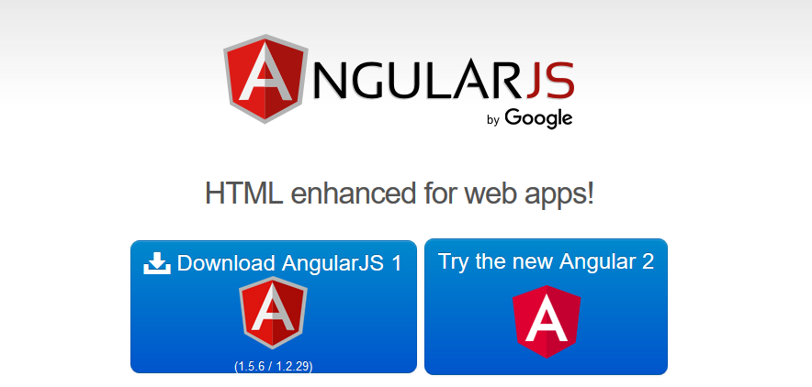
Notes:
angularjs.org
angular.io

Slide 4
Angular < 1.2 - The Big Picture
Module
JS
routes
HTML
($scope)
JS
view
controller
Extend with
Depends on
JS
JS
directives
services
Notes:
You may have

Slide 5
Angular 1.5 - The Big Picture
Module
JS
routes
HTML
View Model
JS
view
component
Extend with
Depends on
JS
JS
directives
services
Notes:
You may have

Slide 6
Angular - The Big Picture
bootstrap
app module
routes
JS
Module Loader
decorator
JS
component
HTML
template
JS
services
JS
directives
Notes:
https://angular.io/docs/ts/latest/guide/attribute-directives.html
Note on Directives
There are three kinds of directives in Angular:
Components
Structural directives
Attribute directives
A Component is really a directive with a template. It's the most common of the three directives and we tend to write lots of them as we build applications.
Structural directives can change the DOM layout by adding and removing DOM elements. NgFor and NgIf are two familiar examples.
An Attribute directive can change the appearance or behavior of an element. The built-in NgStyle directive, for example, can change several element styles at the same time.

Slide 7
Let Us Talk About Angular Versions
Angular implements semantic versioning
The version of Angular doesn’t matter anymore beyond bug fixing purposes. The framework should simply be called Angular
Notes:
http://angularjs.blogspot.com/2016/12/ok-let-me-explain-its-going-to-be.html?m=1
http://angularjs.blogspot.co.uk/2016/10/versioning-and-releasing-angular.html

Slide 8
Set Up the Environment
Pick the language
JavaScript - ES5 (supported in most browsers)
JavaScript - ES6, now called ES2015 (must be transpiled)
TypeScript – superset of JavaScript (must be transpiled)
Pick an editor
Visual Studio
Visual Studio Code
and more…
Notes:
TypeScript is the best choice. You get type checking and as a result great tooling with Visual Studio and VS Code.

Slide 9
Set Up the environment
Install NodeJS/NPM
Install the Angular CLI
Install VS Code – Make sure to select the context menu option to open with VS Code
Setup up your application

Slide 10
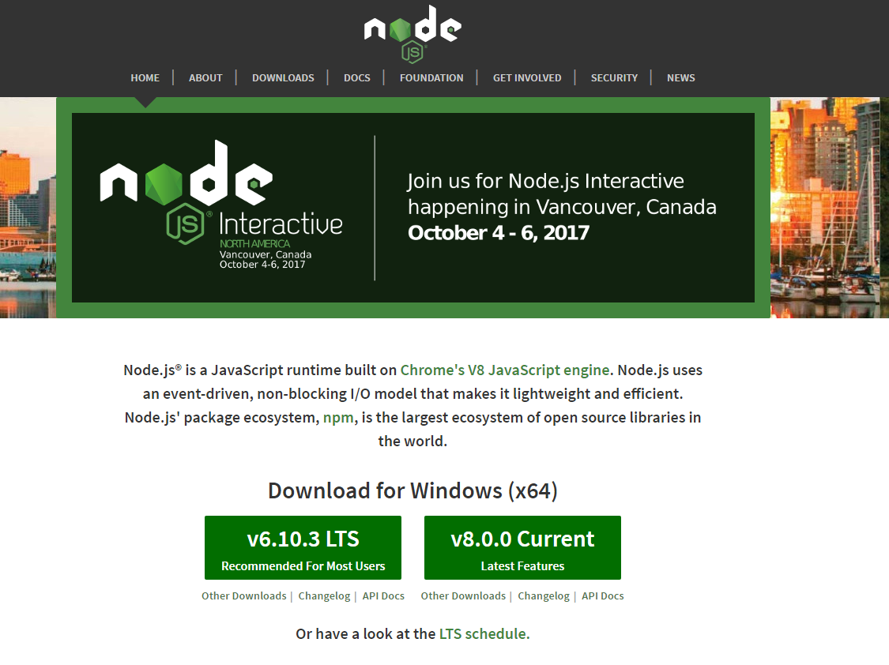
Set Up the Environment

Slide 11
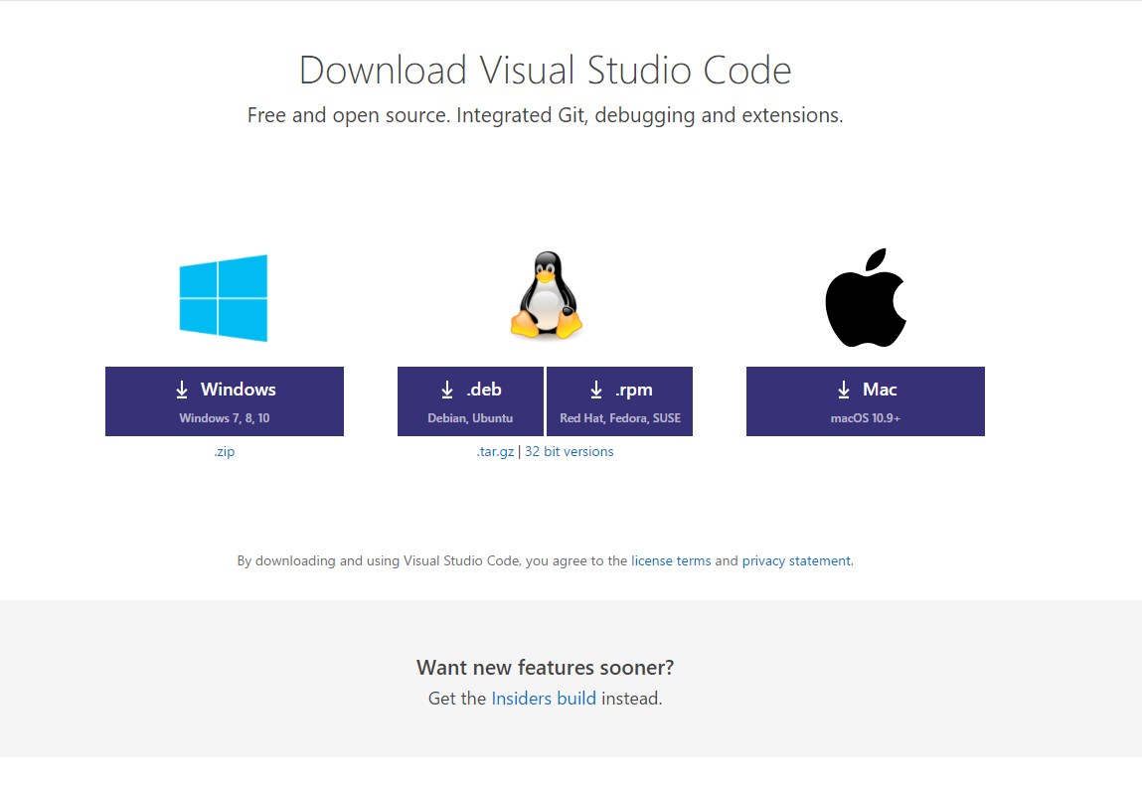
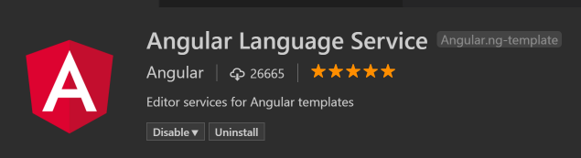
Set Up the Environment
Tip
Recommended Exensiontion
Notes:
Installing node will also install npm

Slide 12
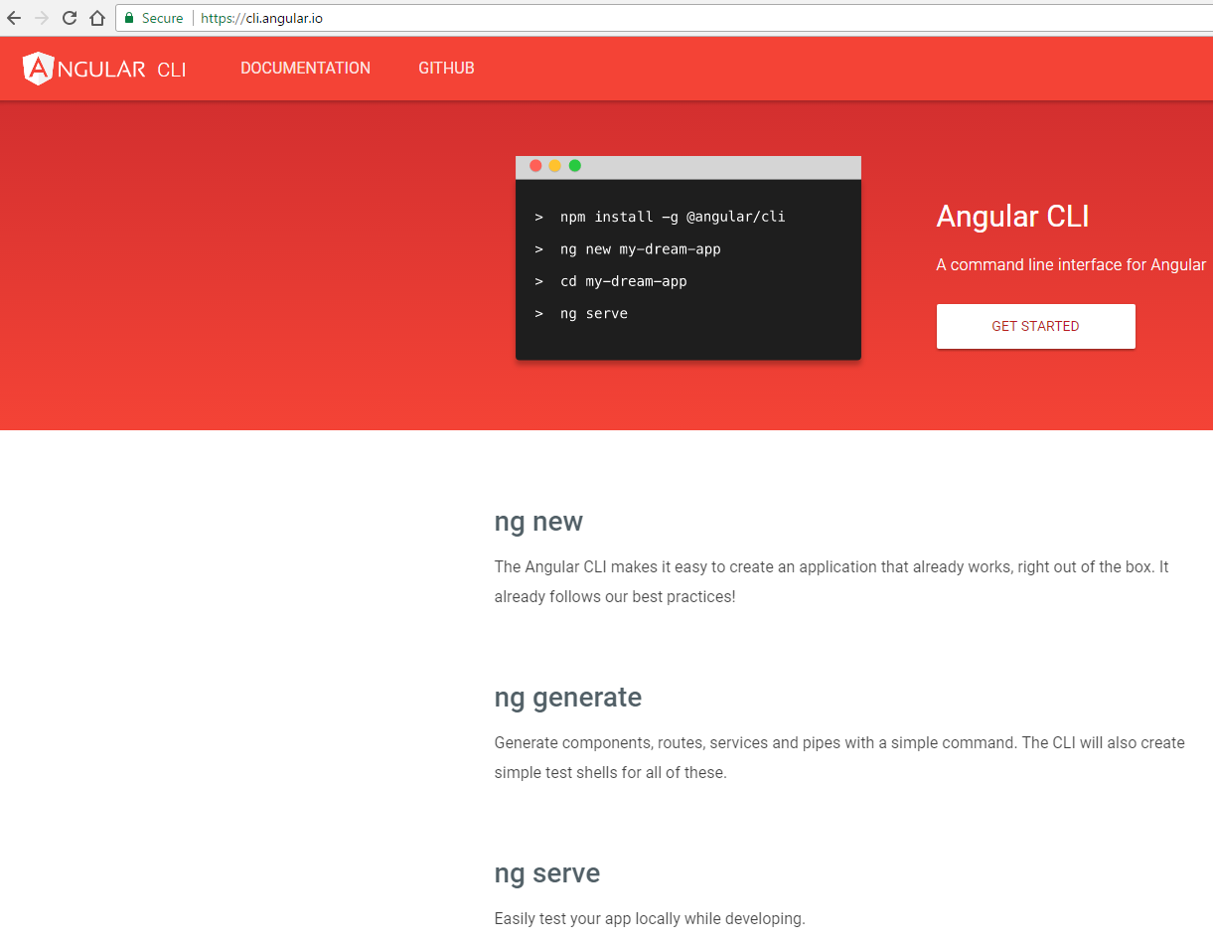
Set Up the Environment
Notes:
Installing node will also install npm

Slide 13
Lab 1
Set Up the Project

Slide 14
Angular Modules
A good example of Angular Module is the router directives and services, they are tightly linked and form a consistent unit
But there could also be application-level modules: imagine an app that is divided into two sets of completely separate screens; we should probably separate them into two different modules
Notes:
@NgModule determines what tags are compiled and what dependencies should be injected
Two roles of the compiler and dependency injection in Angular. Briefly, Angular needs to know what components define valid tags and where dependencies are coming from
http://blog.angular-university.io/angular2-ngmodule/
https://slides.com/laco/ng2-ngmodule-overview/embed

Slide 15
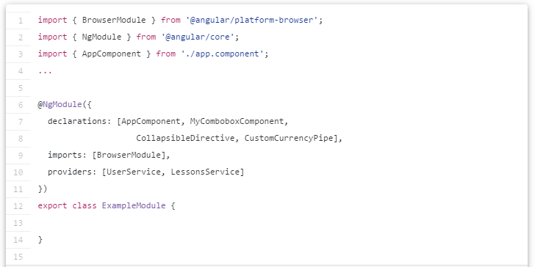
What Does An Angular Module look Like?
We can list the components, directives and pipes that are part of the module in the declarations array
@NgModule annotation is what actually defines the module
We can import other modules by listing them in the imports array
We can list the services that are part of the module in the providers array
Notes:
We can list the services that are part of the module in the providers array, but read further on why this should only be used in some cases

Slide 16
Angular Modules
This declarative grouping is useful if for nothing else for organizing our view of the application and documenting which functionality is closely related
But Angular Modules are more than just documentation, what does Angular exactly do with this information?

Slide 17
Angular Modules
An Angular module allows Angular to define a context for compiling templates
For example when Angular is parsing HTML templates, its looking for a certain list of components, directives and pipes
Each HTML tag is compared to that list to see if a component should be applied on top of it, the same goes for each attribute. The problem is: how does Angular know which components, directives and pipes should it be looking for while parsing the HTML?

Slide 18
Angular Modules
That is when Angular modules come in, they provide that exact information in a single place

Slide 19
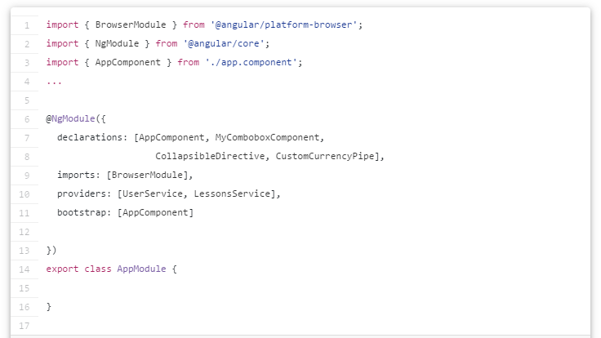
Angular Modules
The root module in the case of web applications imports the BrowserModule, which for example provides Browser specific renderers, and installs core directives like ngIf, ngFor, etc.
The root module has the conventional name of AppModule
The bootstrap property is used, providing a list of components that should be used as bootstrap entry points for the application. There is usually only one element in this array: the root component of the application
Notes:
http://blog.angular-university.io/angular2-ngmodule/

Slide 20
Angular Modules
We can see that this module can quickly grow to contain large arrays as the application grows
Notes:
http://blog.angular-university.io/angular2-ngmodule/

Slide 21
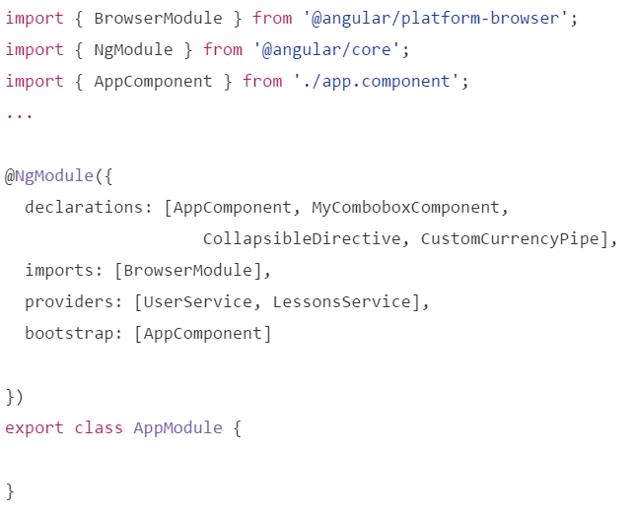
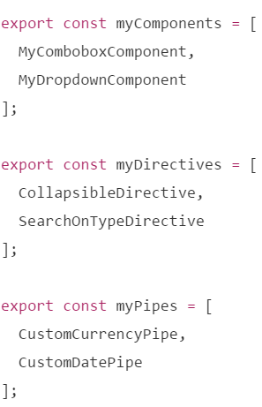
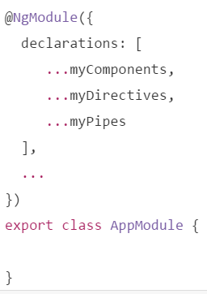
Making Angular Modules More Readable
Before
Including the full list of components within the app.module.ts
After
Using Spread operator

Slide 22
Components
Represent the visual parts of the UI
Contain templates
Attach metadata using decorators
Notes:
https://angular.io/docs/ts/latest/api/core/index/Component-decorator.html

Slide 23
Components
Component
HTML
template (the view)
bindings
directives
decorator
TypeScript
metadata
TypeScript
class
properties
methods

Slide 24
Components
@Component({
templateUrl: 'app/home/about.component.html'
})
export class AboutComponent {
public pageTitle = "About";
}
Decorator for the class
<div class="panel panel-primary">
<div class="panel-heading">
{{pageTitle}}
</div>
<div class="panel-body">
</div>
</div>
Binding Expression
Notes:
Since we use the keyword export, it is now a module (no script tag required)

Slide 25
Components
import { Component } from '@angular/core';
@Component({
selector: 'my-app',
templateUrl: 'app/home/about.component.html',
styleUrls: ['app/home/about.component.css']
})
export class AboutComponent {
public pageTitle = "About";
}
Directive name
Optional stylesheets
<body>
<my-app>Loading...</my-app>
</body>
Include on the page using a directive
Notes:
import is like the using statement in C#
If multiple members should be imported from the same module we can list them in the imports list separated by commas

Slide 26
Components
A component can only belong to one Angular Module
When you make a component part of a module you impose on it a set of rules when it is compiled
Having a component without belonging to a NgModule is meaningless as the compiler can't compile it
Having a component be part of more then one module is also weird as you are saying that depending which module you chose the rules for compiling are different. And when you dynamically load such a component it would be ambiguous which set of compilation rules you wanted
Notes:
https://stackoverflow.com/questions/39486029/share-component-between-2-moduls

Slide 27
Components
But what if reusing the same component across different Angular Modules is required?
As workaround you would create a new Angular Module for the component and add the new module to imports: [...] of the other modules where you want to use it
Notes:
https://stackoverflow.com/questions/39486029/share-component-between-2-moduls

Slide 28
Templates
HTML
Directives
Bindings

Slide 29
Templates
Inside a component
@Component({
selector: 'my-app',
template: '<h1>My First Angular App</h1>'
})
export class AppComponent {}

Slide 30
Templates
Inside a component using multiline
@Component({
selector: 'my-app',
template: `<h1>My App</h1>
<div>
<p>Isn't is pretty?</p>
</div>`
})
export class AppComponent {}
Notes:
Point out the back quote character

Slide 31
Templates
Containing a directive to another component
import { MessageComponent } from ‘./message.component';
@Component({
selector: 'my-app',
template: `<h1>My App</h1>
<my-message></my-message>`
})
export class AppComponent {}
import { MessageComponent } from './message.component';
declarations: [MessageComponent],
Notes:
Bottom window depicts what is added to app.module.ts

Slide 32
Templates
External and referenced from a component
@Component({
selector: 'my-app',
templateUrl: 'demo.component.html'
})
export class AppComponent {}

Slide 33
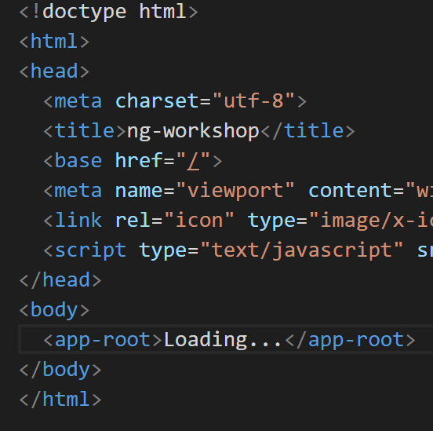
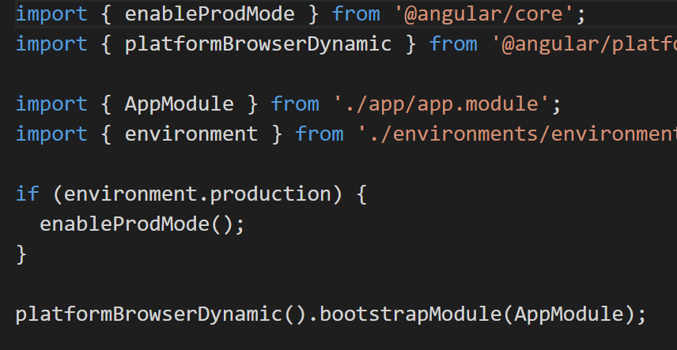
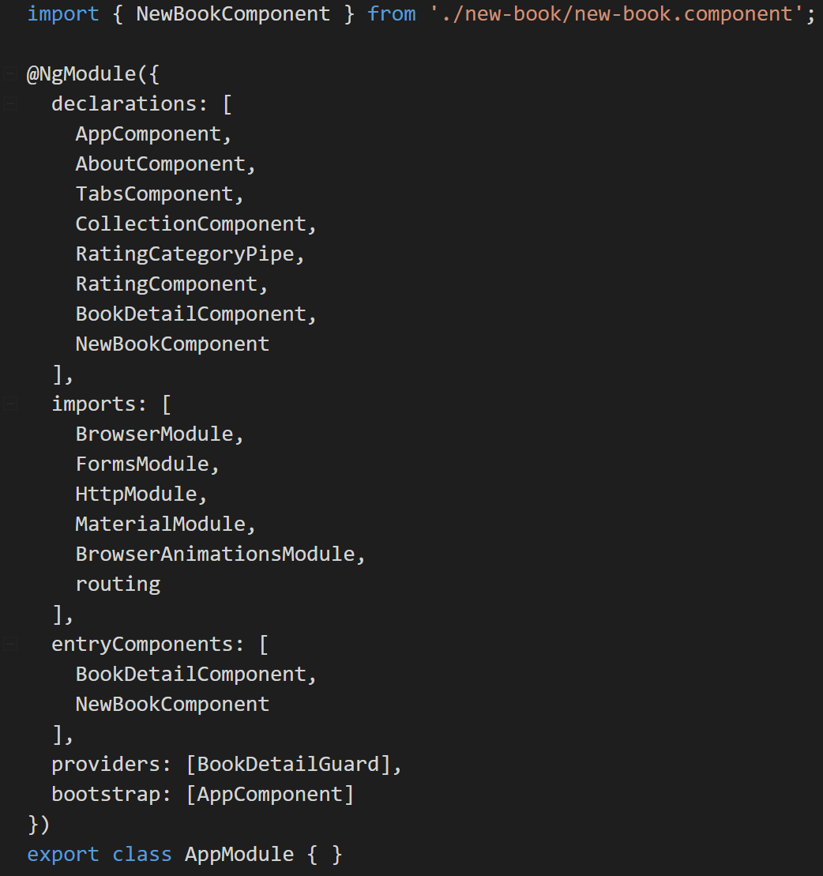
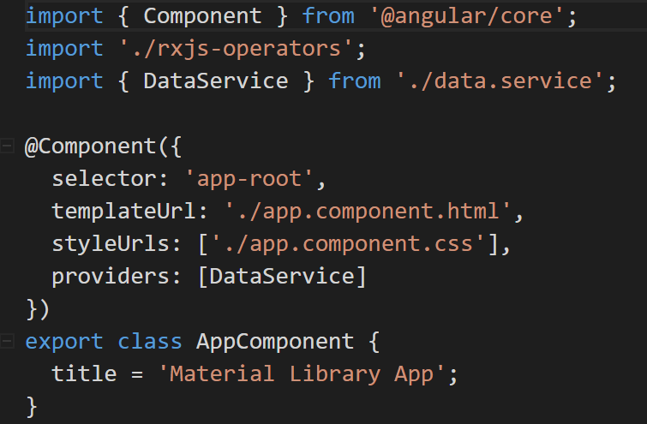
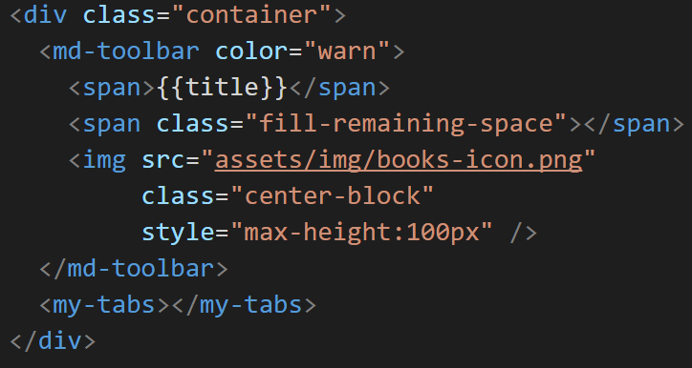
Module Loader
Index.html
Main.ts
App.module.ts
App.component.ts
App.component.html
Notes:
Application starts executing inside the index.html file. This is specified inside the .angular-cli.json

Slide 34
Lab 2
Template Containing a Component

Slide 35
Life without Data Binding
JQuery for everything
Register callbacks for DOM events
Code to find elements in the DOM
Code to manipulate the DOM
Code to inject data into the DOM

Slide 36
Data Binding
Angular’s change detection is based on unidirectional data flow
With the unidirectional data flow you always know where a change to a particular UI element or a component property came from
Notes:
means it's a structural directive
#book of bookTitles was removed in beta.17

Slide 37
Data Binding
These are advantages of Angular’s unidirectional data flow compared to Angular 1:
Easier widget integration
No more $apply
No more repeated digest cycles
No more watchers
No more performance issues with digest cycle and watcher limits
Notes:
means it's a structural directive
#book of bookTitles was removed in beta.17

Slide 38
Data Binding
DOM
Component
{{ Interpolation }}
[ One Way Binding ]
( Event Binding )
[( Two Way Binding )]

Slide 39
Interpolation
{{2 + 2}}
<h1>{{pageTitle}}</h1>
{{amount > 0 ? 'Positive' : 'Negative'}}
{{calculateResult()}}
<span class={{getClass()}}>
Hello
</span>
Expression
export class AppComponent {
pageTitle = "My App";
amount = 100;
calculateResult() { . . .};
getClass() { . . . };
}
Notes:
Read Only option

Slide 40
One Way (Property) Binding
<img [src] = 'item.path' />
<div [hidden] = 'item.isHidden'>Hello</div>
<span [innerText] = 'person.name'></span>
<div [style.color] = 'isOK' ? 'green' : 'red'></div>
Notes:
Read Only option

Slide 41
Interpolation VS One Way Binding
Interpolated: <img src="{{vehicle.imageUrl}}"><br>
Property bound: <img [src]="vehicle.imageUrl">
The interpolated title is {{title}}
[innerHTML]="'The [innerHTML] title is '+title">
Notes:
means it's a structural directive
#book of bookTitles was removed in beta.17

Slide 42
Interpolation VS One Way Binding
Interpolation is a convenient alternative for property binding in many cases
In fact, Angular translates those interpolations into the corresponding property bindings before rendering the view
There is no technical reason to prefer one form to the other
Establish coding style rules and choose the form that both conforms to the rules and feels most natural for the task at hand
Notes:
means it's a structural directive
#book of bookTitles was removed in beta.17

Slide 43
Event Binding
<button (click)='saveItem()'>Save</button>
<input (blur)='saveItem()' />
ng-click
ng-change
ng-keyup
. . .
https://developer.mozilla.org/en-US/docs/Web/Events
Notes:
Read Only option

Slide 44


Two Way Binding
<input [(ngModel)]="item.quantity" />
<select [(ngModel)]="customer.level">
<option value="gold">Gold</option>
<option value="silver">Silver</option>
</select>
import { FormsModule } from '@angular/forms';
@NgModule({
imports: [FormsModule]
})
export class AppModule { }
Notes:
Banana is a box (or is it football in a box?)
FormsModule is required if using 2-way data-binding

Slide 45
Two Way Binding
Any directive that is used inside a component template should be part of the same Angular Module
So where does [(ngModel)] come from?
It comes from FormsModule since [(ngModel)] is usually used when building data entry forms
import { FormsModule } from '@angular/forms';
@NgModule({
imports: [FormsModule]
})
export class AppModule { }
Notes:
means it's a structural directive
#book of bookTitles was removed in beta.17

Slide 46
Lab 3
Data Binding

Slide 47
Pipes
Transform bound properties before display
Built-in pipes
date
number, decimal, percent, currency
json, slice
Etc.
Custom Pipes
Notes:
Showing an object as json is helpful when debugging
Slice a specific subset of elements from a list

Slide 48
Pipes
<p>Score: {{score | percent}}</p>
{{ startDate | date:'shortDate' }}
<pre>{{model | json}}</pre>
{{ total | currency:'USD':true:'1.2-2' }}
https://angular.io/docs/ts/latest/api/#!?apiFilter=pipe
Notes:
Currency parameter means 1 digit to the left of the decimal, 2 digits to the right of the decimal and no more than 2
In order to show the $, you must give the currencyCode in order to specify true for showing the currency symbol

Slide 49
Custom Pipe
import { Pipe, PipeTransform } from '@angular/core';
@Pipe({ name: 'colorRange' })
export class ColorRangePipe implements PipeTransform {
transform(value: number): string {
if (value <= 25) {
return 'red';
}
if (value <= 75) {
return 'yellow';
}
return 'green';
}
}
@Component({
selector: 'my-component',
templateUrl: 'my.component.html'
})
Notes:
,
ngModule:
import { ColorRangePipe } from './color-range.pipe';
pipes: [ColorRangePipe]

Slide 50
Lab 4
Pipes

Slide 51
Directives
With Angular directives we add logic to our HTML such as if statements and for loops
Notes:
means it's a structural directive
#book of bookTitles was removed in beta.17

Slide 52
Three Kinds of Directives
Components
Attribute directives
Structural directives
Notes:
means it's a structural directive
#book of bookTitles was removed in beta.17

Slide 53
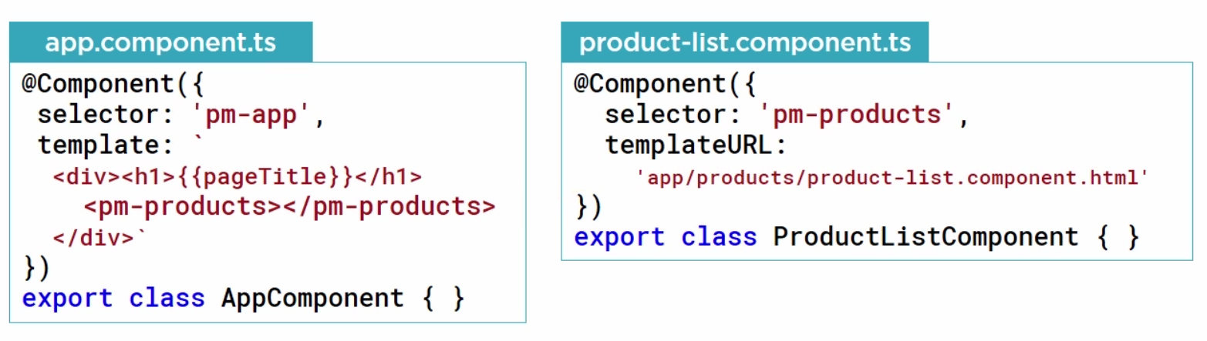
Component Directive
In the example below Angular will look for a component that has a selector called ‘pm-products’

Slide 54
Component Directive
But we can have many components in our application that Angular needs to parse

Slide 55
Component Directive
Angular looks inside the Angular module that owns this component
Each component can belong to one and only one Angular module

Slide 56
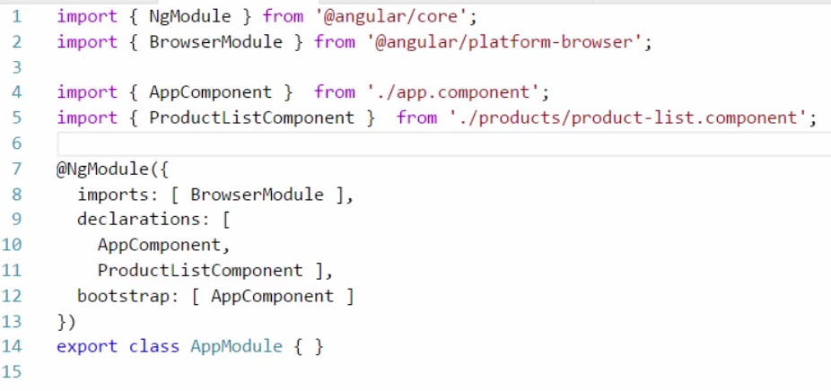
Component Directive
App.module.ts will have to include the ProductListComponent as part of the declarations array

Slide 57
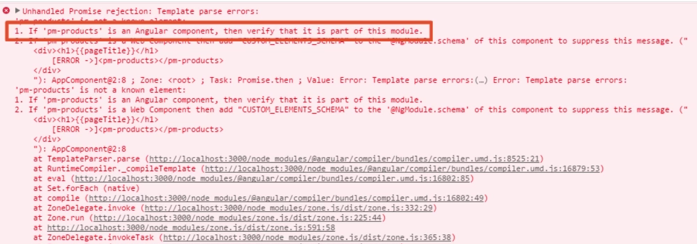
Component Directive
If you forget to include the ProductListComponent in the declarations array the following error will be thrown

Slide 58
Structural Directives
Modifies the layout of the view. Here are two built in structural directives:
*ngIf
*ngFor
<div class="alert alert-danger" *ngIf='errorMessage'>
{{errorMessage}}
</div>
<tr *ngFor='let book of bookTitles'>
<td>{{book}}</td>
</tr>
Notes:
* means it's a structural directive
#book of bookTitles was removed in beta.17

Slide 59
Structural Directives
In the code below the div including the error message will be removed from the DOM when the errorMessage property is not set to a value
<div class="alert alert-danger" *ngIf='errorMessage'>
{{errorMessage}}
</div>
<tr *ngFor='let book of bookTitles'>
<td>{{book}}</td>
</tr>
Notes:
* means it's a structural directive
#book of bookTitles was removed in beta.17

Slide 60
Structural Directives
Wait…Didn’t we just say that an Angular module defines the boundary or context within which the component resolves its directives and dependencies?
<div class="alert alert-danger" *ngIf='errorMessage'>
{{errorMessage}}
</div>
<tr *ngFor='let book of bookTitles'>
<td>{{book}}</td>
</tr>
Notes:
* means it's a structural directive
#book of bookTitles was removed in beta.17

Slide 61
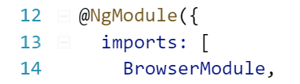
Structural Directives
How will our application find this *ngIf directive?
BrowserModule exposes these directives
<div class="alert alert-danger" *ngIf='errorMessage'>
{{errorMessage}}
</div>
<tr *ngFor='let book of bookTitles'>
<td>{{book}}</td>
</tr>
Notes:
* means it's a structural directive
#book of bookTitles was removed in beta.17

Slide 62
Building Better Components
Components are one of the key building blocks of an Angular application
The cleaner the components are the better the application

Slide 63
How Can We make Our Components Better?
Strong Typing and Interfaces
Encapsulating Styles
Lifecycle Hooks
Relative Paths with Module Id

Slide 64
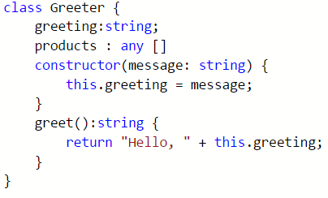
Strong Typing and Interfaces
One of the benefits of using TypeScript is strong typing
Every property has a type
Every parameter has a type
Every method has a return type
In some cases we have a property or a method that doesn’t have a predefined type

Slide 65
Strong Typing and Interfaces
One of the benefits of using TypeScript is strong typing
Using ‘any’ negates the benefits of strong typing

Slide 66
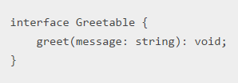
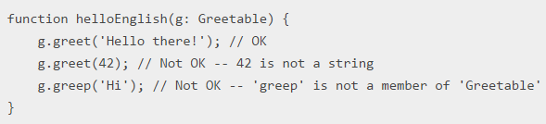
Strong Typing and Interfaces
To specify a custom type we can define an Interface

Slide 67
Strong Typing and Interfaces
Interfaces are only a compile-time construct and have no effect on the generated code
ES 2015 does not support it yet

Slide 68
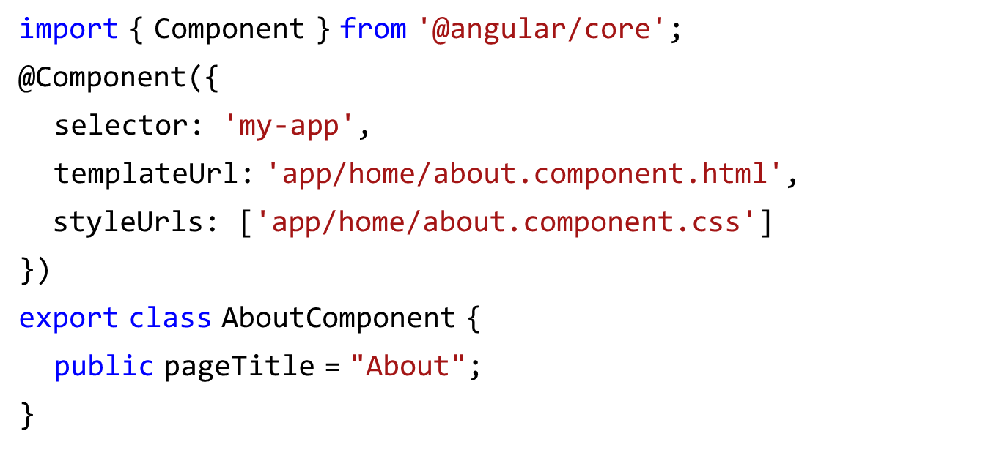
Encapsulating Styles
Encapsulated Styles

Slide 69
Lifecycle Hooks
A component lifecycle is managed by Angular

Slide 70
Component Lifecycle
Create
Render
Create & Render Children
ngOnDestroy
(right before component destroyed
ngOnChanges
(after databound properties changed)
ngOnInit
(after data-bound input properties initialized)
Process Changes
Destroy
Notes:
Process changes - when data bound is changed
Destroy - Destroys the component when its template is removed from the DOM
ngOnInit – good for loading data using a data service
ngOnChanges – watches for changes to input properties
We are showing the three most widely used hooks
ngOnInit
ngOnChanges
ngOnOnDestroy
Here is the full list of hooks
https://angular.io/docs/ts/latest/guide/lifecycle-hooks.html

Slide 71
Lifecycle Hooks
import { Component, OnInit } from 'angular2/core';
@Component({ . . . })
export class AboutComponent implements OnInit {
private pageTitle = "About";
ngOnInit() {
// do some initialization
// This is a best practice to do initialization in ngOnInit // instead of the constructor
// Components are easier to test and debug when their // constructors are simple and all real work (especially // calling a remote server) is handled in a separate method
}
}
Notes:
This is a best practice to do initialization in ngOnInit instead of the constructor.
Components are easier to test and debug when their constructors are simple and all real work (especially calling a remote server) is handled in a separate method.

Slide 72
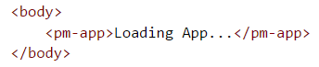
Using a Component
There are two ways to use a component
As a directive: App Component or Nested Component
As a routing target: This makes it appear to the user that they have navigated to another view
Notes:
The routing target option is discussed later in the presentation

Slide 73
Building Nested Components
What makes a component nest-able?
Its template manages a fragment of a larger view
It has a selector
It optionally communicates with its parent component (the container)

Slide 74
Communication between Parent and Child Components
Container Component
<div (click)='update()'>
. . .
</div>
Template
<my-nested-component
[value]='container.value'>
(hello)='onHello($event)'>
</my-nested-component>
Nested Component
Template
[value] Input
Class
@Input() value
@Output() hello
@Output() hello: EventEmitter<string> = new EventEmitter<string>();
update() {
this.hello.emit('hi');
}
Raises an Event

Slide 75
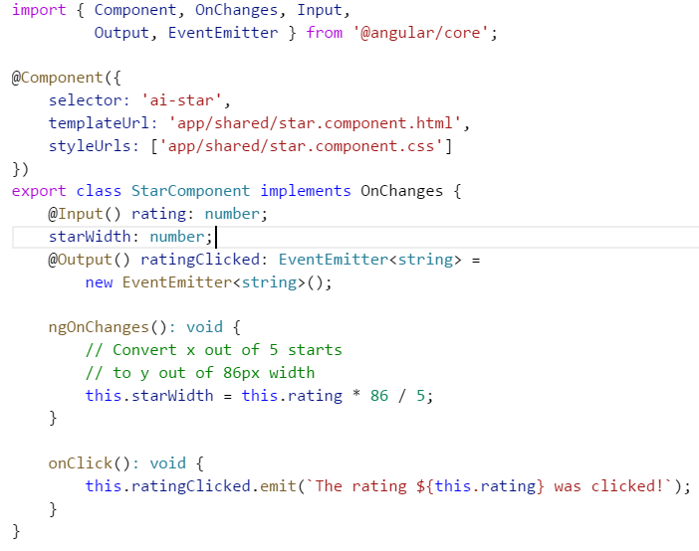
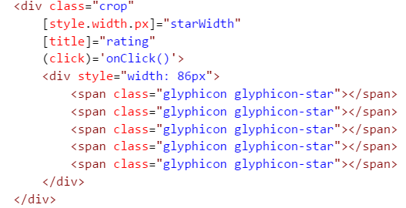
Communication between Parent and Child Components
Child Component

Slide 76
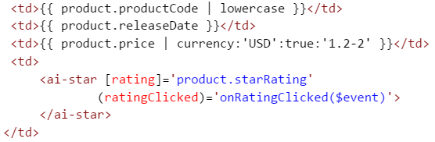
Communication between Parent and Child Components
Child Component
Parent Component Template
Child Component
Watches for changes to input properties

Slide 77
Communication between Parent and Child Components
Child Component
Parent Component Template
Child Component
triggers changes through the output properties

Slide 78
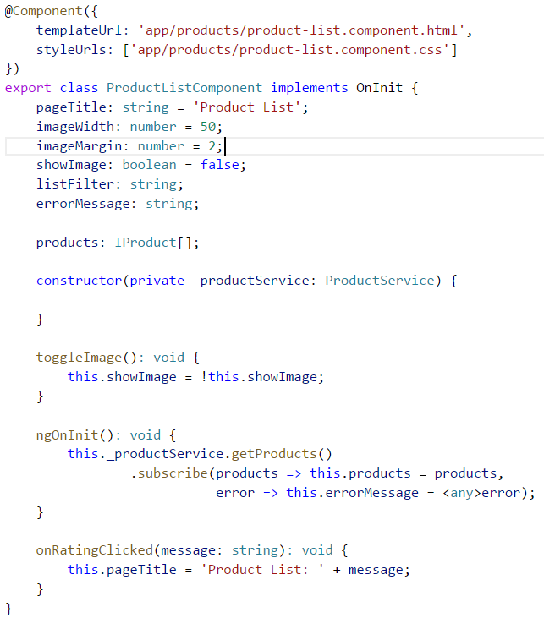
Communication between Parent and Child Components
Parent Component
The event triggered from the child component executes the onRatingclicked in the parent component. The parameter is passed using the $event

Slide 79
Lab 5
Communication Between Parent and Child Components

Slide 80
Services
Components are great, but what do we do with data or logic that is not associated with a specific view or that we want to share across components?
We Build Services

Slide 81
Services
Two ways to utilize a service from within a component
Creating a local instance which makes it hard to test
Service
export class MyDataService {}
Component
Let svc = new MyDataService ();

Slide 82
Services
Two ways to utilize a service from within a component
Register the service with Angular which creates a single instance of the service class (singleton)
Injector
Log
Math
myService
Service
export class MyDataService {}
Component

Slide 83
Services
If you register it twice (in different components) then you get 2 instances (no longer a singleton). The injector will keep track of both.

Slide 84
Services
Angular Injector
Define your service
http
@Injectable()
export class MyDataService {
getCustomers(): ICustomer[] {...}
}
routeParams
log
Component
Register a provider
myDataService
Use your service
constructor(private _myDataService: MyDataService) {
}
myConstants
Notes:
@Injectable only required if your service has its own dependencies, but recommended to always put it on.
When you register a provider the service will be available in that component and all of that component's children.
If you register it twice (in different components) then you get 2 instances (no longer a singleton). The injector will keep track of both.

Slide 85
Services
private _myDataService;
constructor(myDataService : MyDataService) {
_myDataService = myDataService;
}
This is such a common pattern that TypeScript defined a shorthand syntax for all of this code
constructor(private _myDataService: MyDataService) {
}

Slide 86
Register a provider
Inside a component
import { MyDataService } from './data.service';
@Component({
selector: 'my-app',
template: '<h1>My First Angular App</h1> ',
providers: [myDataService]
})
export class AppComponent {}
Could also be added to the Angular Module providers if needed across all the components within an Angular Module
Notes:
myDataService is now available to be used in any components below this one.

Slide 87
Lab 6
Build a Service

Slide 88
AJAX
NOTE: Option to fallback to promises
Angular 1
Angular
$http – returns a Promise
Http – return Observable
Promise
returns a value when:
done,
upon error,
during progress
Observable
returns multiple values over time
can be cancelled
supports array operators (map, filter, etc.)

Slide 89
Promise VS. Observable
Promise | Observable
Provides a single future value | Emits multiple values over time
Not lazy. By the time you have a promise its on its way to being resolved | Lazy. Observables won’t emit values until they are subscribed to
Not cancellable (resolved or rejected and only once) | Cancellable by unsubscribing
 | Supports map, filter, reduce, and similar operators

Slide 90
Observables
Not supported in JavaScript yet
Proposed feature for ES 2016
Must use Reactive Extensions (RxJS)
Write a method that subscribes to an Observable to receive asynchronous notifications
The method reacts as data is pushed to it
Method is notified when no more data (or error)
Observable works like an array
map() is used to transform the incoming data
Notes:
map(x => x * 10). E.g. if we have a sequence of 1,2,3 it will become 10, 20,30
Note on RxJX methods:
The RxJS library is quite large. We should include only those features that we actually need.
Accordingly, Angular exposes a stripped down version of Observable in the rxjs/Observable module, a version that lacks most of the operators including some we'd like to use.
It's up to us to add the operators we need.
We could add every RxJS operators with a single import statement. While that is the easiest thing to do, we'd pay a penalty in extended launch time and application size.
Instead, we'll import each Observable operator and static class method, one-by-one, until we have a custom Observable implementation tuned precisely to our requirements.
We'll put the import statements in one app/rxjs-operators.ts file.

Slide 91
Subscribing To An Observable
With promises you receive the result of the promise by calling “then”
E.g. x.then( valueFn , errorFn )
valueFn: Called when the promise completes successfully
errorFn: Handles any error condition

Slide 92
Subscribing To An Observable
If x was an observable the “then” is replaced with “subscribe”
x.subscribe( valueFn , errorFn )
Since observables handle multiple values over time the valueFn is called for each value the observable emits
In some cases we want to know when the observable completes. The subscribe provides a third optional function
x.subscribe( valueFn , errorFn, completeFn )
let sub = x.subscribe( valueFn , errorFn, completeFn )
subscribe returns a subscription that can be used to call unsubscribe and cancel the subscription if needed

Slide 93
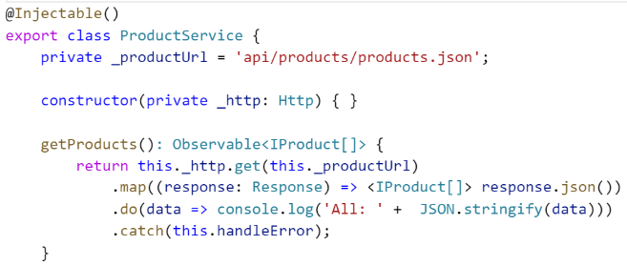
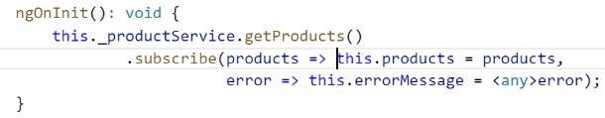
Subscribing To An Observable
The Complete Picture
Translate the response object to an array of products
This is done with the map operator which takes the raw http response object and maps it to an array of products
Observables are lazy which means that it won’t start emitting values until subscribe is called
The function passed to the subscribe method specifies an action to take whenever the observable emits an item
Since http calls are single async operations, only one item is emitted which is the http response object that was mapped to a product array in the service

Slide 94
Lab 7
Http Service

Slide 95
Routing
Configure a route for each component that wants to display its view
Define options/actions
e.g. Menu item
Tie a route to each option/action
Activate the route based on user action
Activating a route displays the component’s view

Slide 96
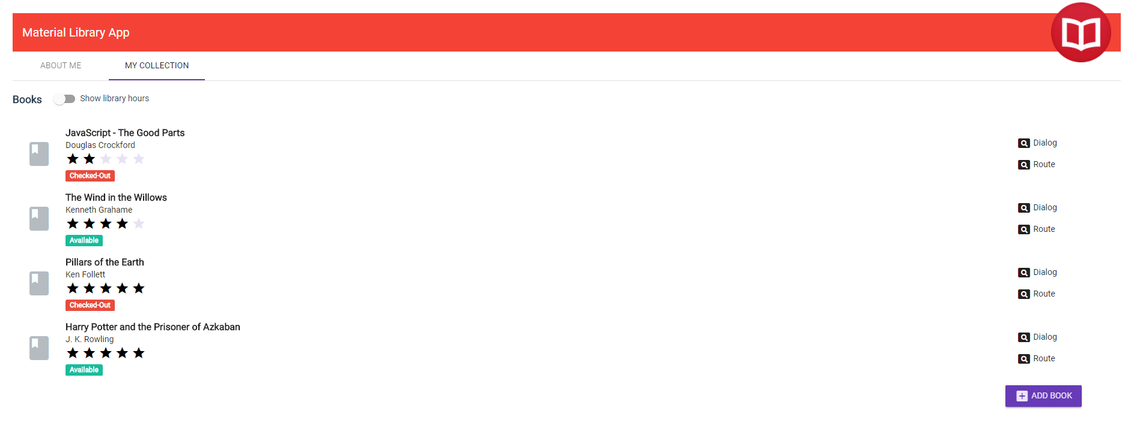
Routing
We tie a route to each menu option using a built in directive called routerLink
<a [routerLink]=[‘/collection’]> My Collection</a>
The [‘/collection’] portion is a template expression that returns a link parameters array. E.g. we could have passed a product id as the second parameter in the array
By default Angular uses HTML5 style URLs which doesn’t require # symbol to indicate local navigation. E.g. www.myservice.com/library
By using HTML5 style URLs you will need to configure your web server to support URL rewriting
Angular also supports # style routing which does not require URL rewriting

Slide 97
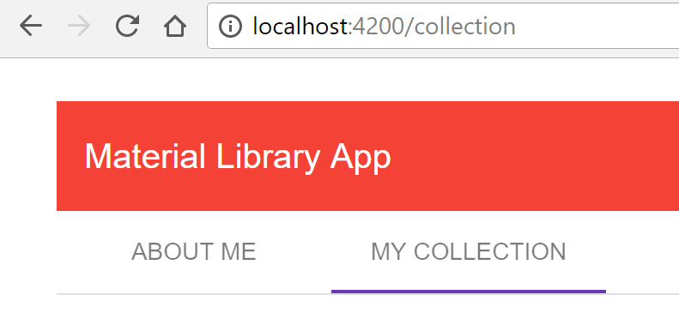
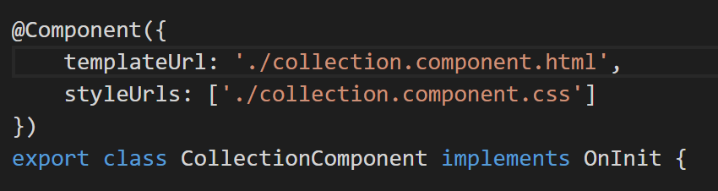
Routing
We tie a route to each menu option using a built in directive called routerLink
<a routerLink=“/collection”> My Collection </a>
When clicking the menu option the address bar reflects the change
The angular router looks for a route definition matching the path segment below
{ path: ‘collection’, component: CollectionComponent }
Notice that the collection component doesn’t have a selector as its not nested but instead used as part of routing

Slide 98
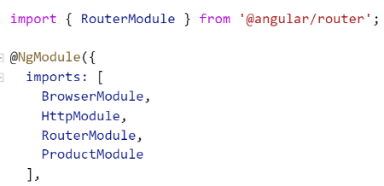
Configuring Routes
Angular application has one router that is managed by Angular’s router service
Before we use the service we need to register the router service provider in an angular module
Similar to the HttpModule the router provider is registered inside the RouterModule

Slide 99
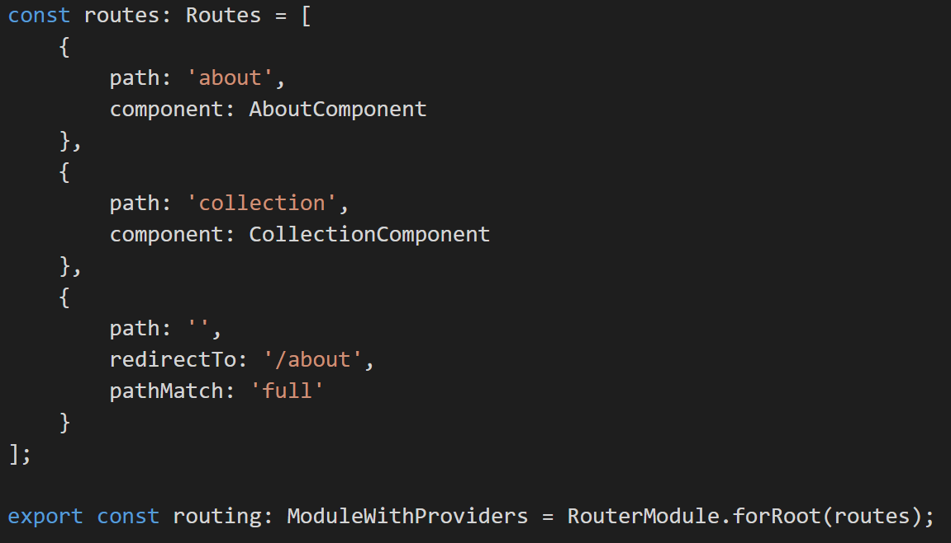
Configuring Routes
The router must be configured with a list of routes
We set the list of route definitions that are available for our application using the forRoot method
The order of the paths in the array matters. More specific routes should always come before less specific routes like the **

Slide 100
Configuring Routes
The router must be configured with a list of routes
Each definition specifies a route object
Path: Defines the URL path segment.
We can also have a route parameter using the colon. E.g. {path: ‘product/:id,…)
The empty path ‘ ‘ defines the default route
** denotes a wildcard path. In this example we are redirected to the welcome page if the requested url does not match any prior paths
No leading slashes in the paths
Notes:
We can define any number of parameter separated with slashes

Slide 101
Configuring Routes
The router must be configured with a list of routes
Each definition specifies a route object
Component: Component associated with the route

Slide 102
Configuring Routes
The router must be configured with a list of routes
Each definition specifies a route object
redirectTo: redirects to page. It requires a pathMatch to tell the router how to match the url path segment to the path of a route
By setting pathMatch to ‘full’ we are telling the router that we only want this default route when the entire client side portion of the path is empty
pathMatch:
full | prefix
Notes:
pathMatch: 'full' means, that the whole URL path needs to match and is consumed by the route matching algorithm.
pathMatch: 'prefix' means, the first route where the path matches the start of the URL is chosen, but then the route matching algorithm is continuing searching for matching child routes where the rest of the URL matches.
http://stackoverflow.com/questions/39945137/angular2-router-config-prefix-pathmatch-does-not-work
If we wanted to use the hash style routes instead of HTML 5 route style routes we change the code to RouterModule.forRoot( [], {useHash:true} )

Slide 103
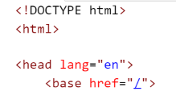
Configuring Routes
The base element tells the router how to compose navigation URLs
In our example since the app folder is the application root we will set the href for the base tag to /
Notes:
https://angular.io/docs/ts/latest/guide/router.html#!#base-href

Slide 104
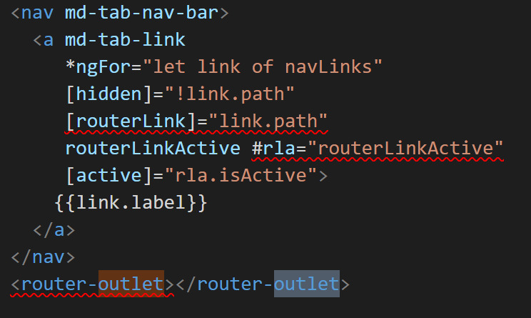
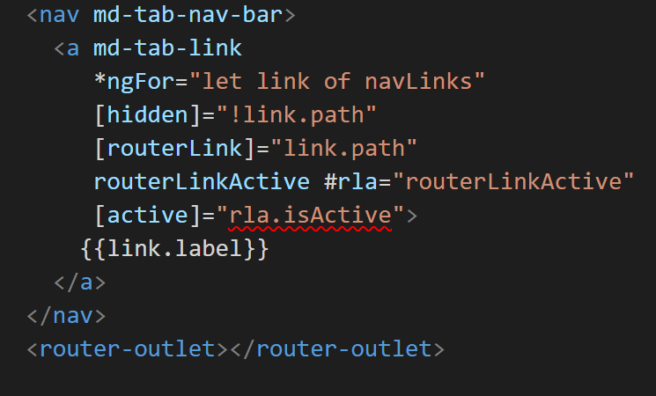
Placing the Views
When a route is activated the associated component’s view is displayed
To specify where we want the routing component to display its view we use the <router-outlet>

Slide 105
Lab 8
Routing

Slide 106
Advanced Routing
Passing parameters to a route
Activating a route with code
Protecting routes with guards

Slide 107
Passing parameters to a route
Sometimes we need to pass a parameter in the route
E.g. http://localhost:3000/collection/1
First step is to configure the routes with parameters
E.g. { path : ‘collection/:id’, component : BookDetailComponent }
With the route definition we need to add a [routerLink] which takes a parameter
E.g. <a [routerLink] = “[ ‘/collection’ , book.bookId ] “>

Slide 108
Passing parameters to a route
We access the router parameter using the ActivatedRoute service
import {ActivatedRoute } from ‘@angular/router’
Two ways to retrieve the parameter
snapshot: If we only need to get the initial value of the parameter
constructor( private _route : ActivatedRoute ) { console.log(this._route.snapshot.params[‘id’]); }
For example if the user is always returned to the library before navigating to a new book so the snapshot approach would be sufficient
observable: If you expect the parameter to change without leaving the page then you will need to use an observable. For example if we had a next button on the book detail page to display the next book the url will change to the next book’s id

Slide 109
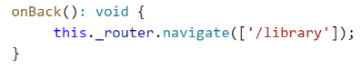
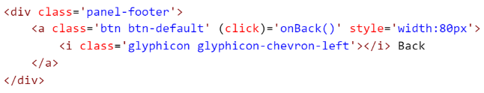
Activating a route with code
So far we have been activating routes using the routerLink directive
E.g. <a [routerLink] = “[ ‘/collection’ , book.bookId ] “>
Routes can be activated using code
A typical use case is when you have a save button which would require executing some code to save the data and then route

Slide 110
Lab 9
Passing Parameters To a Route and Activating a Route
with Code

Slide 111
Protecting Routes With Guards
You want to limit routes to specific users
E.g. admin only
You want to confirm a navigation operation
E.g. asking the user to save before navigating away from an edit page
Angular router provides several guards
CanActivate: Guard navigation to a route
CanDeactivate: Guard navigation away from a route
Resolve: Pre-fetch data before activating a route
CanLoad: Prevent asynchronous routing
The guards service provider must be provided at the Angular Module level

Slide 112
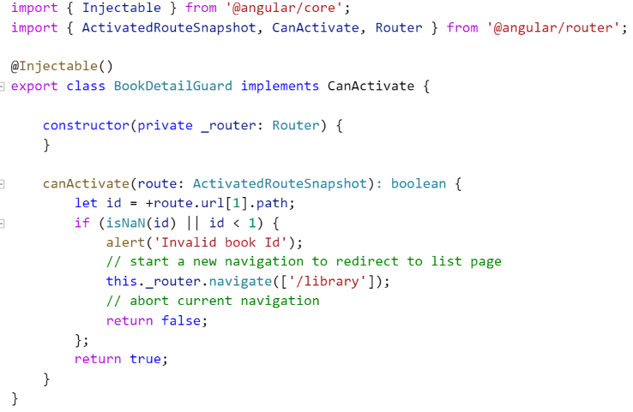
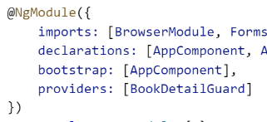
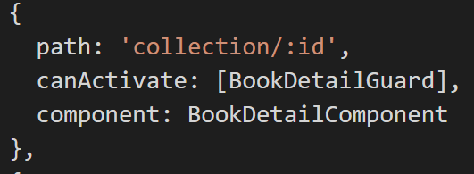
Protecting Routes With Guards

Slide 113
Lab 10
Protecting Routes with Guards
Notes:
Test with id 0 to see how the navigation goes back to the collection page.
Here is the check currently hard wired into the guard
if (isNaN(id) || id < 1) {

Slide 114
Forms
A form creates a cohesive, effective, and compelling data entry experience
An Angular form coordinates a set of data-bound user controls, tracks changes, validates input, and presents errors

Slide 115
Forms
Angular Form Technologies
Template-driven Forms | Reactive Forms

Slide 116
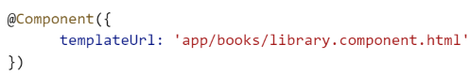
Forms
Angular Form Technologies
Template-driven Forms | Reactive Forms
Use a Component’s Template

Slide 117
Forms
Angular Form Technologies
Template-driven Forms | Reactive Forms
Use a Component’s Template
Unit Test Against DOM
This could be difficult and slow in a lot of circumstances
For example the validation might exist in HTML5 attributes like ‘require’ ‘minlength’ ‘maxlength’ which is usually up to the browser to take care of that

Slide 118
Forms
Angular Form Technologies
Template-driven Forms | Reactive Forms
Use a Component’s Template | Use a Component’s Template
Unit Test Against DOM

Slide 119
Forms
Angular Form Technologies
Template-driven Forms | Reactive Forms
Use a Component’s Template | Use a Component’s Template
Unit Test Against DOM | Create a Form Model in TypeScript (this must be in sync with the template)
You are somewhat repeating yourself

Slide 120
Forms
Angular Form Technologies
Template-driven Forms | Reactive Forms
Use a Component’s Template | Use a Component’s Template
Unit Test Against DOM | Create a Form Model in TypeScript (this must be in sync with the template)
 | Unit Test Against Form Model
Can lead to faster unit testing

Slide 121
Forms
Angular Form Technologies
Template-driven Forms | Reactive Forms
Use a Component’s Template | Use a Component’s Template
Unit Test Against DOM | Create a Form Model in TypeScript (this must be in sync with the template)
 | Unit Test Against Form Model
 | Validation in Form Model
Validation doesn’t necessarily need to be in the DOM
It can be put directly in the Form Model

Slide 122
Forms
Angular Form Technologies
Template-driven Forms | Reactive Forms
Use a Component’s Template | Use a Component’s Template
Unit Test Against DOM | Create a Form Model in TypeScript (this must be in sync with the template)
 | Unit Test Against Form Model
 | Validation in Form Model

Slide 123
Forms
Steps involved in building a form
Build an Angular form with a component and template
Two-way data bind with [(ngModel)] syntax for reading and writing values to input controls
Track the change state and validity of form controls using ngModel in combination with a form
Provide strong visual feedback using special CSS classes that track the state of the controls
Display validation errors to users and enable/disable form controls
Use template reference variables for sharing information among HTML elements

Slide 124
Form Component
There’s nothing special about a form component
Nothing form-specific, nothing to distinguish it from any component we've written before

Slide 125
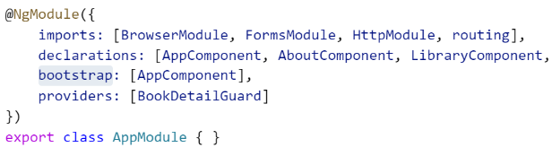
Form Component
There’s nothing special about a form component
Nothing form-specific, nothing to distinguish it from any component we've written before
We need to add the FormsModule to the array of imports before we can use forms
This gives our application access to all of the template-driven forms features, including ngModel

Slide 126
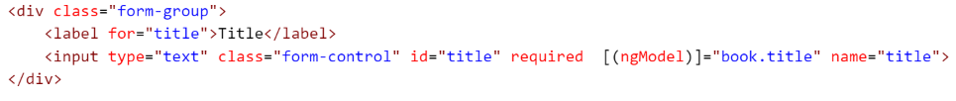
Two-way data binding with ngModel
Enables Two-way binding on the input element
Defining a name attribute is a requirement when using [(ngModel)] in combination with a form
Internally Angular creates FormControls and registers them with an NgForm directive that Angular attached to the <form> tag. Each FormControl is registered under the name we assigned to the name attribute

Slide 127
Track change-state and validity with ngModel
A form isn't just about data binding. We'd also like to know the state of the controls on our form
Using ngModel in a form gives us more than just two way data binding. It also tells us if the user touched the control, if the value changed, or if the value became invalid

Slide 128
Track change-state and validity with ngModel
The ngModel directive doesn't just track state; it updates the control with special Angular CSS classes that reflect the state. We can leverage those class names to change the appearance of the control and make messages appear or disappear

Slide 129
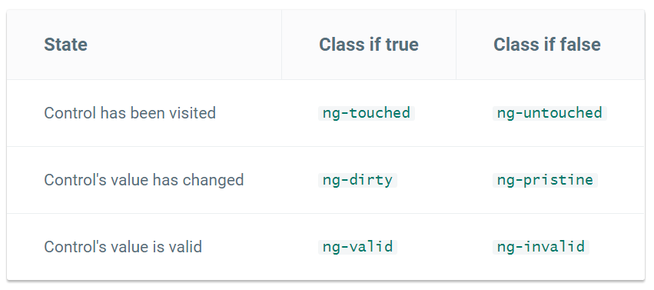
Track change-state and validity with ngModel

Slide 130
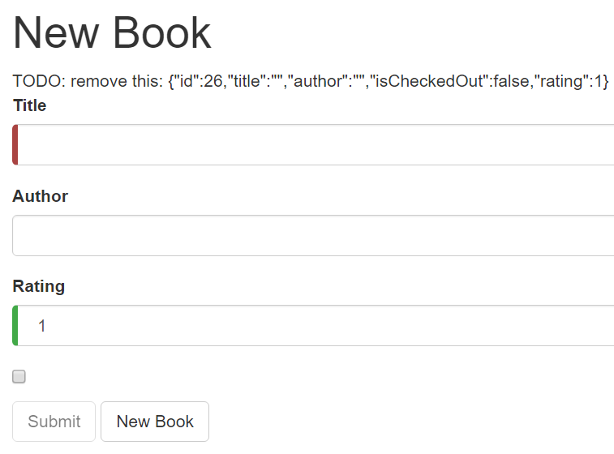
Add Custom CSS for Visual Feedback
Invalid State
Valid State

Slide 131
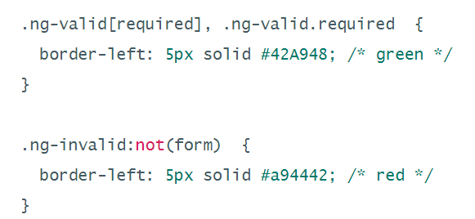
Add Custom CSS for Visual Feedback

Slide 132
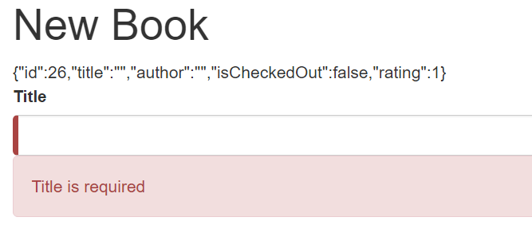
Show and Hide Validation Error messages
Validation Message

Slide 133

Show and Hide Validation Error messages
We need a template reference variable to access the input box's Angular control from within the template. Here we created a variable called titleSpy and gave it the value "ngModel"
Why is the reference variable set to "ngModel"?
A directive's exportAs property tells Angular how to link the reference variable to the directive. We set name to ngModel because the ngModel directive's exportAs property happens to be "ngModel"

Slide 134
Show and Hide Validation Error messages
Now we can control visibility of the “Title" error message by binding properties of the title control to the message <div> element's hidden property
In this example, we hide the message when the control is valid or pristine; pristine means the user hasn't changed the value since it was displayed in this form

Slide 135


What About Resetting The Form?
Data Entered
The form remembers that we entered data before clicking New Book. Replacing the book object did not restore the pristine state of the form controls

Slide 136



What About Resetting The Form?
We have to clear all of the flags imperatively which we can do by calling the form's reset() method after calling the newBook() method
Now clicking "New Book" both resets the form and its control flags. The required message doesn’t show up as now the title field is pristine

Slide 137
Submit The Form With ngSubmit
The Submit button at the bottom of the form does nothing on its own but it will trigger a form submit because of its type (type="submit")
To make "form submit" useful, the <form> tag needs NgSubmit

Slide 138

Submit The Form With ngSubmit
What about #newbookForm template reference?
The variable newbookForm is now a reference to the NgForm directive that governs the form as a whole

Slide 139

Submit The Form With ngSubmit
Bind the button's disabled property to the form's over-all validity via the newBookForm variable

Slide 140
Lab 11
Adding Forms
Notes:
More info about entry components
https://angular.io/docs/ts/latest/cookbook/ngmodule-faq.html#!#q-entry-component-defined

Slide 141
Testing
We have two types of tests
Unit
End-to-End

Slide 142
Unit Tests
Test components in isolation, without external resources (e.g. file system, database, API endpoints)

Slide 143
Unit Tests
In Angular world this means testing your Component in isolation without its Template and any other resources that touch external resources (e.g. file system, database, API endpoints)

Slide 144
Unit Tests
Component
Template

Slide 145
Unit Tests
Service
Component
Router

Slide 146
Unit Tests
FakeService
Component
Router
Notes:
You assume the service is doing its functionality properly and basically give a ‘fake service’

Slide 147
Unit Tests
FakeService
Component
FakeRouter
Notes:
FakeRouter – Not a real router that works with the browser API that takes the user to a different page

Slide 148
Unit Tests
Easiest to write
Fast
Doesn’t give us much confidence

Slide 149

Unit Tests
We can think about the component as a simple Typescript class that can be tested in isolation
For example we can test if the value of the totalVotes increases when the upVote is triggered
We don’t care that it has a Template
Notes:
In the test we call upVote and check if the value has been updated properly – and that would simply be your unit test

Slide 150
Unit Tests
The downside of unit testing in this case though is that if there is a problem in the bindings of this component we will not know until runtime

Slide 151
Unit Tests
For example if you forget to bind the click event of this button to the upload method then the component won’t function properly
Notes:
And that’s when you use integration tests

Slide 152
End-to-End Tests
Test the entire application as a whole
We simulate a real user
We lunch the application in the browser
Navigate between pages
Maybe Even log in

Slide 153
End-to-End Tests
More confidence
Very slow
Each test is going to lunch the application in the browser, navigate to the home page, then perhaps do a few clicks here and there and do something
Very fragile
A simple change in the application markup can break these tests even if the application is working properly

Slide 154
Ideal Testing Plan
A lot of Unit Tests
Few
End-to-end Tests
Only for the key functions of the application
Notes:
Limit end to end tests only for the key functions of the application

Slide 155
Fundamentals of Testing
Unit Tests are first class citizens
Small functions / methods (10 lines of code or less)
Proper naming
Single responsibility

Slide 156
Demo 5
Unit Testing In Angular
Notes:
Go through the different under the Unit Testing section here
https://codecraft.tv/courses/angular/unit-testing/overview/
https://medium.com/google-developer-experts/angular-2-testing-guide-a485b6cb1ef0

Slide 157
Main concepts
Suites — describe(string, function) functions, take a title and a function containing one or more specs.
Specs — it(string, function) functions, take a title and a function containing one or more expectations.
Expectations — are assertions that evaluate to true or false. Basic syntax reads expect(actual).toBe(expected)
Matchers — are predefined helpers for common assertions. Eg: toBe(expected), toEqual(expected). Find a complete list here.

Slide 158
Setup and teardown
Jasmine offers four handlers to add our setup and teardown code:
beforeEach, afterEach executed for each spec
beforeAll, afterAll executed once per suite.
A good practice to avoid code duplication on our specs is to refactor repetitive code into the setup.

Slide 159

In the beforeEach function for our test suite we configure a testing module using the TestBed class.
This creates a test Angular Module which we can use to instantiate components, perform dependency injection and so on.
We configure it in exactly the same way as we would configure a normal NgModule. On this case we pass in the LoginComponent in the declarations and the AuthService in the providers.

Slide 160
// create component and test fixture fixture = TestBed.createComponent(LoginComponent); // get test component from the fixture component = fixture.componentInstance; // UserService provided to the TestBed authService = TestBed.get(AuthService);
Once the Angular Testing Bed is setup we can then use it to instantiate components and resolve dependencies, like so:
Notes:
A fixture is a wrapper for a component and it’s template.
We create an instance of a component fixture through the TestBed, this injects the AuthServiceinto the component constructor.
We can find the actual component from the componentInstance on the fixture.
We can get resolve dependencies using the TestBed injector by using the get function.

Slide 161

Now we’ve configured the TestBed and extracted the component and service we can run through some tests:
Notes:
A Spy is a feature of Jasmine which lets you take an existing class, function, object and mock it in such a way that you can control what gets returned from functions.

Slide 162
Demo 6
E2E Testing In Angular
Notes:
https://coryrylan.com/blog/introduction-to-e2e-testing-with-the-angular-cli-and-protractor

Slide 163
e2e Testing
In our Angular CLI project we have a folder named e2e. This is where our e2e tests are kept.
There are two parts to writing an E2E test with Protractor. First is our Page Object Class located in the app.po.ts file.
Our Page Object Class is a Class that describes a high level page view.
The Page Object Class has all of the logic to find the elements on our page and how to navigate to the URL.
This Page Object finds our home page heading. We use the Protractor by.css() function to select elements on the page.

Slide 164
The second part is our actual app.e2e-spec.ts file
This is where we describe our e2e tests
We first import our Page Object class to use and create a new Page instance in the beforeEach function.
This will create a new isolated test page for each E2E test. With Jasmine we give a description to the test with the it() function.
The it function takes a function to execute and runs an expectation to make sure the test passes. In our test we run page.navigateTo(); to browse to our home page.
The first test we run expect(page.getParagraphText()).toEqual(‘BNP Paribas App’); which is what we are expecting
To run our tests we run the following command in our Angular CLI project: ng run e2e. This will trigger Protractor to open the browser to start our app and run our tests

Slide 165
Webpack: An Introduction
Webpack is a popular module bundler, a tool for bundling application source code in convenient chunks and for loading that code from a server into a browser
It's an excellent alternative to the SystemJS approach

Slide 166
A Quick Comparison
SystemJS
Universal dynamic module loader - loads ES6 modules, AMD, CommonJS and global scripts in the browser and NodeJS.
You still have work to do (with Gulp for example) to package your Angular2 application for production
Webpack
Webpack is a flexible module bundler
It goes further and doesn't only handle modules but also provides a way to package your application (concat files, uglify files, ...)
It also provides a dev server with load reload for development
Notes:
Systemjs vs webpack
http://stackoverflow.com/questions/38263406/what-are-differences-between-systemjs-and-webpack

Slide 167
Webpack: An Introduction
What is a bundle?
A bundle is a JavaScript file that incorporate assets that belong together and should be served to the client in a response to a single file request
A bundle can include JavaScript, CSS styles, HTML, and almost any other kind of file

Slide 168
Webpack: An Introduction
Webpack roams over your application source code, looking for import statements, building a dependency graph, and emitting one (or more) bundles
With plugin "loaders" Webpack can preprocess and minify different non-JavaScript files such as TypeScript, SASS, and LESS files

Slide 169
Webpack: An Introduction
We determine what Webpack does and how it does it with a JavaScript configuration file webpack.config.js
But the CLI never generated a webpack.config.js file
ng eject ejects your app and outputs the proper webpack configuration and scripts
Notes:
https://github.com/angular/angular-cli/issues/1656

Slide 170
ng eject
ng eject simply means you need to do something a lot more advanced or custom with webpack than what the cli provides for commands like ng build and ng serve
It generates a webpack.config.js based on the configurations that the cli uses which you can further customize
Notes:
https://github.com/angular/angular-cli/wiki/eject
https://github.com/angular/angular-cli/issues/6302

Slide 171

Webpack: Entries and Outputs
We feed Webpack with one or more entry files and let it find and incorporate the dependencies that radiate from those entries
E.g. you can start from the application's root file, src/app.ts:

Slide 172

Webpack: Entries and Outputs
Webpack inspects that file and traverses its import dependencies recursively

Slide 173
Webpack: Entries and Outputs
In this example it sees that we're importing @angular/core so it adds that to its dependency list for (potential) inclusion in the bundle
It opens @angular/core and follows its network of import statements until it has build the complete dependency graph from app.ts down

Slide 174

Webpack: Entries and Outputs
It outputs these files to the app.js bundle file designated in configuration:
This app.js output bundle is a single JavaScript file that contains the application source and its dependencies

Slide 175

Webpack: Entries and Outputs
Multiple Bundles
We probably do not want one giant bundle of everything
We'll likely prefer to separate our volatile application app code from comparatively stable vendor code modules
Webpack constructs two separate dependency graphs and emits two bundle files
[name] is a placeholder for the different file names

Slide 176
Webpack: Loaders
Webpack can bundle any kind of file: JavaScript, TypeScript, CSS, SASS, LESS, images, html, fonts, etc.
Webpack itself doesn't know what to do with a non-JavaScript files
We teach it to process such files into JavaScript with loaders

Slide 177

Webpack: Loaders
Here we configure loaders for TypeScript and CSS:
As Webpack encounters import statements like these:
import { AppComponent } from './app.component.ts';
import 'uiframework/dist/uiframework.css';
it applies the test RegEx patterns. When a pattern matches the filename, Webpack processes the file with the associated loader
The first import file matches the .ts pattern so Webpack processes it with the awesome-typescript-loader. The imported file doesn't match the second pattern so its loader is ignored
The second import matches the second .css pattern for which we have two loaders chained by the (!) character. Webpack applies chained loaders right to left so it applies the css loader first (to flatten CSS @import and url(...) statements) and then the style loader (to append the css inside <style> elements on the page).

Slide 178

Webpack: Plugins
Webpack has a build pipeline with well-defined phases
We tap into that pipeline with plugins such as the uglify minification plugin:

Slide 179
Webpack: Set Up
Manually add it to your project
Automatically have it setup by creating an Angular application using the Angular CLI

